Slide 1

Algorithms and Data Structures 1 CS 0445
Fall 2023
Introduction to Algorithm Analysis
Sherif Khattab
ksm73@pitt.edu
(Slides are adapted from Dr. Ramirez’s and Dr. Farnan’s CS1501 slides.)

Slide 2
Announcements
Upcoming Deadlines:
Lab 2: Friday 9/22 @ 11:59 pm
Programming Assignment 1: Friday 9/29 @ 11:59 pm
Post-lab exercises are optional
SCI Week is happening this week!
Please make your Piazza posts public as much as possible

Slide 3
Agenda
Code efficiency
How to determine running time of an algorithm without running it?
Count the number of executed basic operations
as a function of the input size
Determine the order of growth of the runtime function
Ignore lower order terms
Ignore constant factors
Big-Oh approximation

Slide 4
Why do we care about efficient code?
Computers are faster, have larger memories
So why worry about efficient code?
And … how do we measure efficiency?

Slide 5

Example
Consider the problem of summing: computing the sum 1 + 2 + . . . + n for an integer n > 0

Slide 6
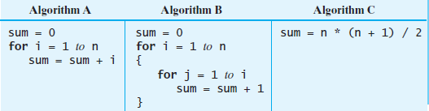
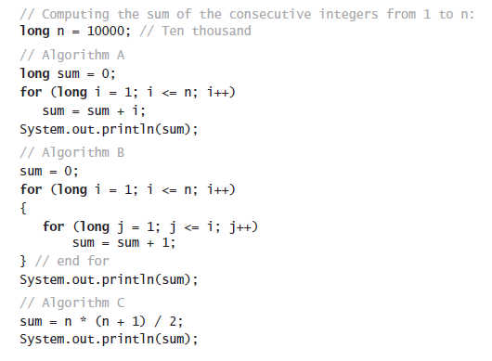
One solution

Slide 7
Another solution

Slide 8
And a third solution

Slide 9
Which is “best”?
An algorithm has both time and space constraints – that is complexity
Time complexity
Space complexity
The study of time and space (and other) complexities of algorithms is called analysis of algorithms

Slide 10
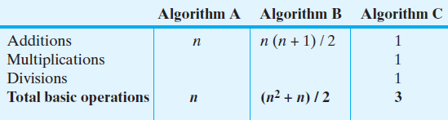
Counting Basic Operations
A basic operation of an algorithm
The most significant contributor to its total time requirement
The number of basic operations required by the sum algorithms

Slide 11
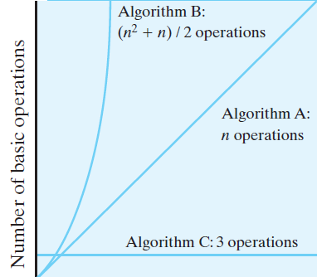
Counting Basic Operations
The number of basic operations required by the sum algorithms as a function of n

Slide 12
Time complexity of an algorithm
Count the number of executed steps (basic operations or just lines of code)
sum = 0
for i = 1 to n
sum = sum + i
Number of executed lines is 2n + 2
Let f(n) = the number of executed steps
n is the input size
very roughly, the number of keyboard presses needed to enter the input
f(n) may depend only on n or on the actual values of the input
In the latter, need to find f(n) for best, average, worst cases

Slide 13
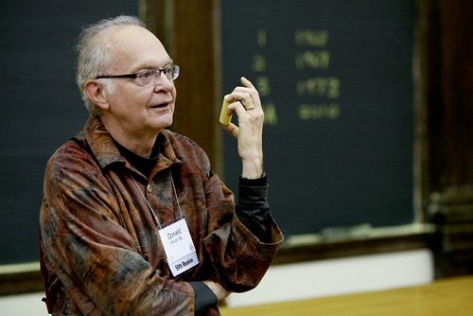
Mathematically modelling runtime
Runtime primarily determined by two factors:
Cost of executing each statement
Determined by machine used, environment running on the machine, etc.
Frequency of execution of each statement
Determined by program and input
https://www.youtube.com/watch?v=EE1R8FYUJm0
Notes:
Knuth's approach to modelling runtime

Slide 14
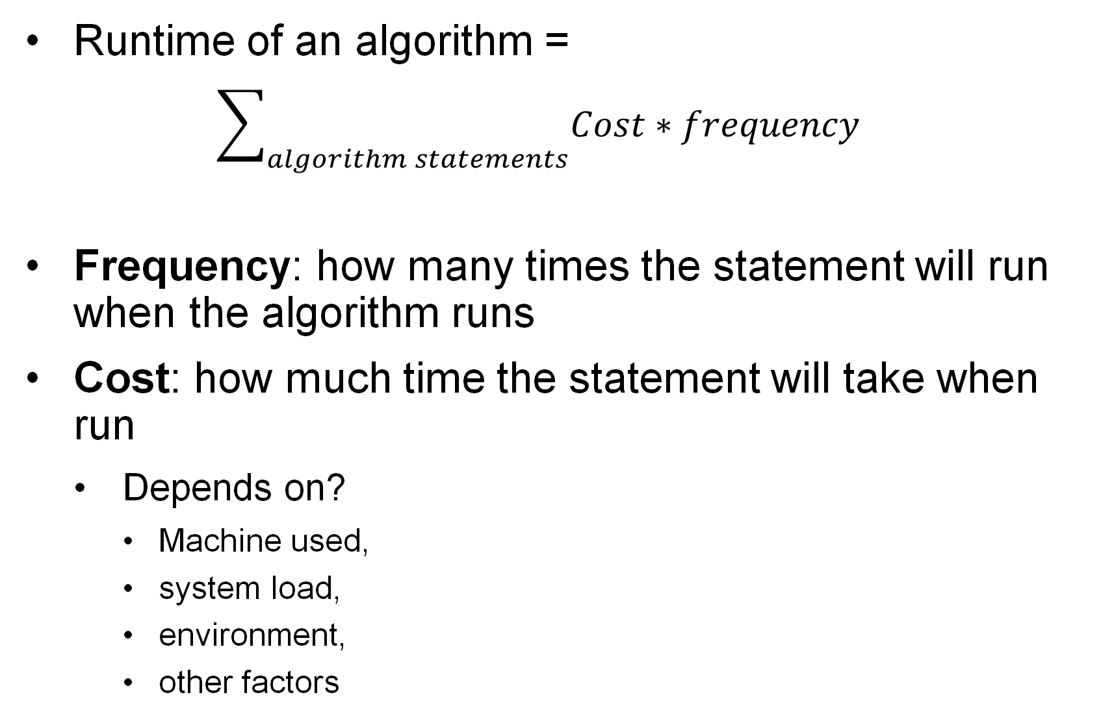
What is the runtime?
Runtime of an algorithm =
$$\sum_{algorithm statements}{Cost∗frequency}$$
Frequency: how many times the statement will run when the algorithm runs
Cost: how much time the statement will take when run
Depends on?
Machine used,
system load,
environment,
other factors
Notes:
grey:
time: t₄
freq: 1
yellow:
time: t₃
freq: n
blue:
time: t₂
freq: sum i=0 to n-1 ( sum j=i+1 to n-1 (1))
= n²/2 - n/2
red:
time: t₁
freq: sum i=0 to n-1 ( sum j=i+1 to n-1 ( sum k=j+1 to n-1 (1)))
= n³/6 - n²/2 + n/3
purple
time: t₀
freq: x (depends on if statement, min 0 max same as red)
SUM UPPER BOUNDS: INCLUSIVE

Slide 15
Example
public int sum(int[] a, int n) {
int sum = 0;
for (int i = 0; i <n; i++) { sum = sum + a[i];
}
return sum;
}
frequency = ?
1
frequency = ?
n
frequency = ?
frequency = ?
n+1
frequency = ?
n
1
frequency = ?
1

Slide 16
Example 1
public int sum(int[] a, int n) {
int sum = 0; for (int i = 0; i < n; i++) {
sum = sum + a[i]; } return sum; }
How much time does that statement take?
Let’s assume it is a constant

Slide 17
Example 1
public int sum(int[] a, int n) {
int sum = 0; for (int i = 0; i < n; i++) {
sum = sum + a[i]; } return sum; }
How many times does that statement execute in one run of the algorithm?
Just once!

Slide 18
Example 1
public int sum(int[] a, int n) {
int sum = 0; for (int i = 0; i < n; i++) {
sum = sum + a[i]; } return sum; }
Cost = some constant
frequency = 1

Slide 19
Example 1
public int sum(int[] a, int n) {
int sum = 0; for (int i = 0; i < n; i++) {
sum = sum + a[i]; } return sum; }
Cost = some constant
frequency = 1

Slide 20
Example 1
public int sum(int[] a, int n) {
int sum = 0; for (int i = 0; i < n; i++) {
sum = sum + a[i]; } return sum; }
Cost = some constant
frequency = 1

Slide 21

Small Optimization
Group the statements that have the same frequency into one block
$\sum_{all blocks}{Cost∗frequency}$

Slide 22
Example 1
public int sum(int[] a, int n) {
int sum = 0; for (int i = 0; i < n; i++) {
sum = sum + a[i]; } return sum; }
Cost = t₀
frequency = 1

Slide 23
Example 1
public int sum(int[] a, int n) {
int sum = 0; for (int i = 0; i < n; i++) {
sum = sum + a[i]; } return sum; }
Cost = t₁
frequency = n

Slide 24
Example 1
public int sum(int[] a, int n) {
int sum = 0; for (int i = 0; i < n; i++) {
sum = sum + a[i]; } return sum; }
Cost = t₂
frequency = n+1

Slide 25

What is the running time?
$\sum_{all blocks}{Costof block∗frequency of block}$
= t₀*1 + t₁*n + t₂*(n+1)
public int sum(int[] a, int n) {
int sum = 0; for (int i = 0; i < n; i++) {
sum = sum + a[i]; } return sum; }

Slide 26
Algorithm Analysis Example 2
public int sum(int[] a, int n, int x) {
int sum = 0; for (int i = 0; i < n; i++) {
if(a[i] > x){
sum = sum + a[i]; }
} return sum; }
freq = 1
freq = n
freq = n + 1
0 <= freq <= n

Slide 27
Algorithm Analysis Example 3
public int sum(int[] a, int n) {
int sum = 0; for (int i = n-1; i >= 1; i = i/2) {
sum = sum + a[i];
} return sum; }
freq = 1
freq = log n
freq = log n + 1

Slide 28
Enter Asymptotic Analysis
Algorithm Analysis
Determine resource usage as a function of input size
e.g., in Example 1, n, the length of the summed range, is the input size
We already did that for Example 1
Measure asymptotic performance
Performance as input size increases to infinity
Notes:
Storytime:
Implemented a new algorithm and it runs forever
Problem with the algorithm?
Or just a bug?
What if the implementation doesn't end up being worth it?
What if the algorithm is infeasible?
STILL USEFUL!
Experimental evaluation
Benchmarking

Slide 29
Asymptotic performance
Focus on the order of growth of functions, not on exact values

Slide 30
Asymptotic performance
Order of growth captures how fast the function value increases when the input increases; in particular, for a function T(n)
When n doubles, does T(n) essentially
stay constant
increase by a constant
double as well
quadruple (x4)
increase eightfold (x8)
… ?
When n increases by 1, does T(n) essentially
double
increase n-fold (xn)
… ?

Slide 31
Asymptotic performance
We don’t care as much about the exact value of T(n)

Slide 32
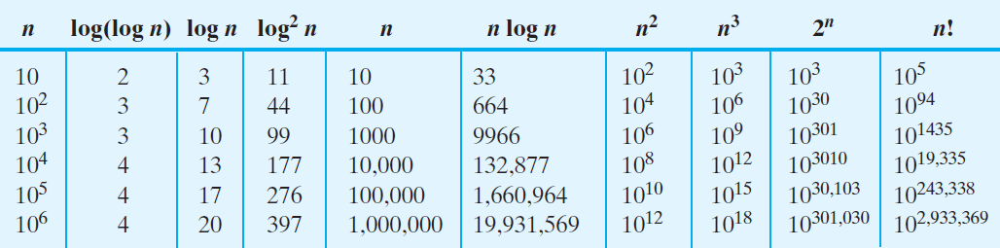
Counting Basic Operations
Typical growth-rate functions evaluated at increasing values of n

Slide 33
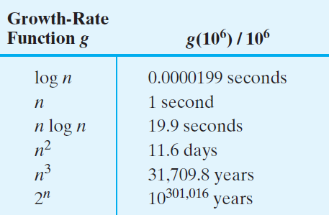
Picturing Efficiency
The time required to process one million items by algorithms of various orders at the rate of one million operations per second

Slide 34
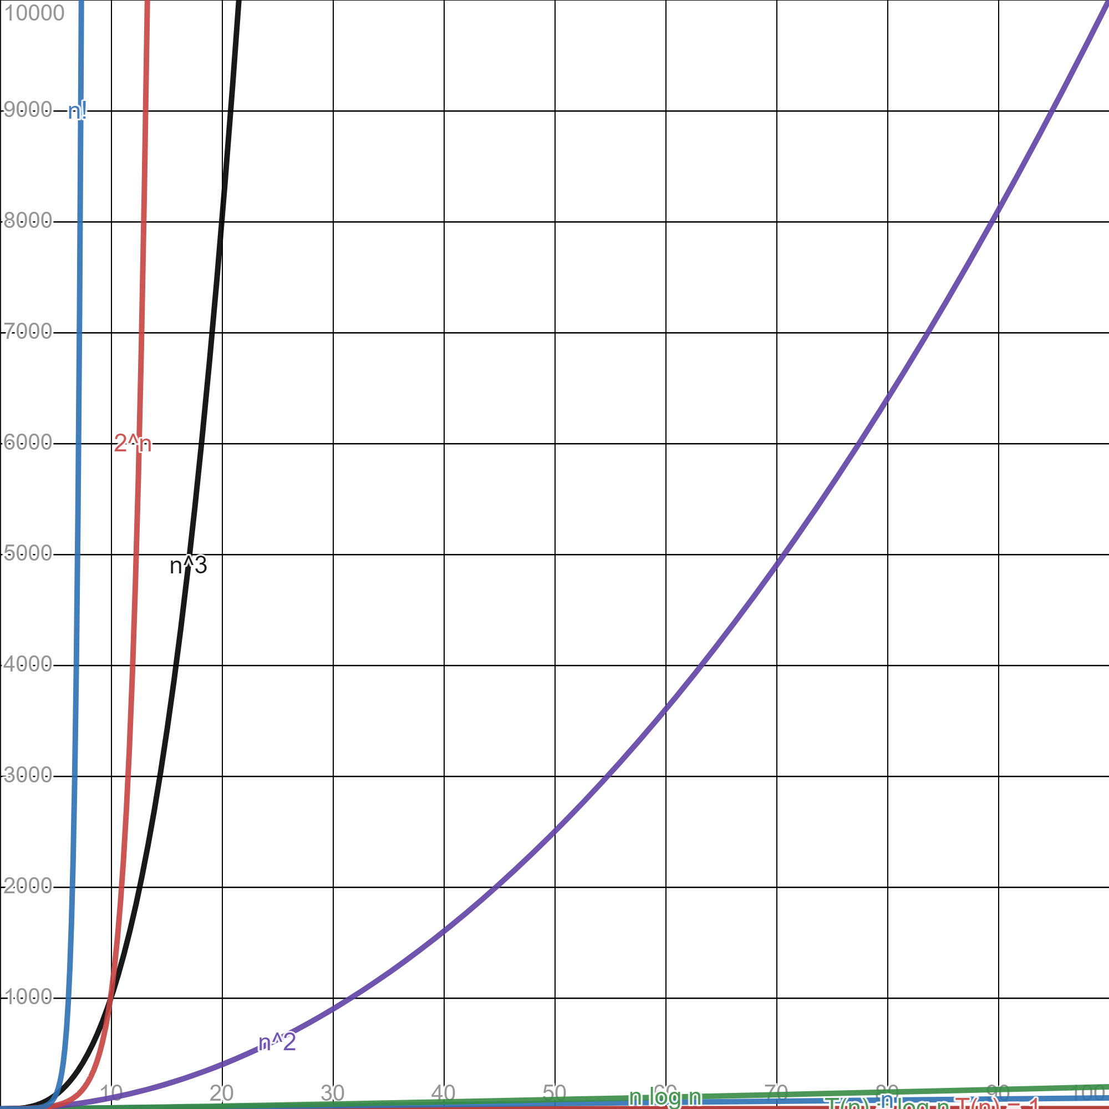
Common orders of growth in Algorithm Analysis
Constant - 1
Logarithmic - log n
Linear - n
Linearithmic - n log n
Quadratic - n²
Cubic - n³
Exponential - 2^{n}
Factorial - n!
https://www.desmos.com/calculator/tgud0bb1mz

Slide 35

Side note
What does $\log_{2}n$ really mean?
$\log_{2}n$ is the number of times n can be divided by 2 before until we reach 1 or less

Slide 36
Side note
Why do we use T(n) instead of f(x)?
T stands for Time, or running time
Using n signifies that the input is a positive integer

Slide 37
Order of growth of runtime functions
For runtime functions, is it better to have a function with a high order of growth or a low order of growth?
low order of growth means when input size increases, the value of the runtime won’t increase by much
This means a fast algorithm
So, we want a low order of growth function for runtime

Slide 38
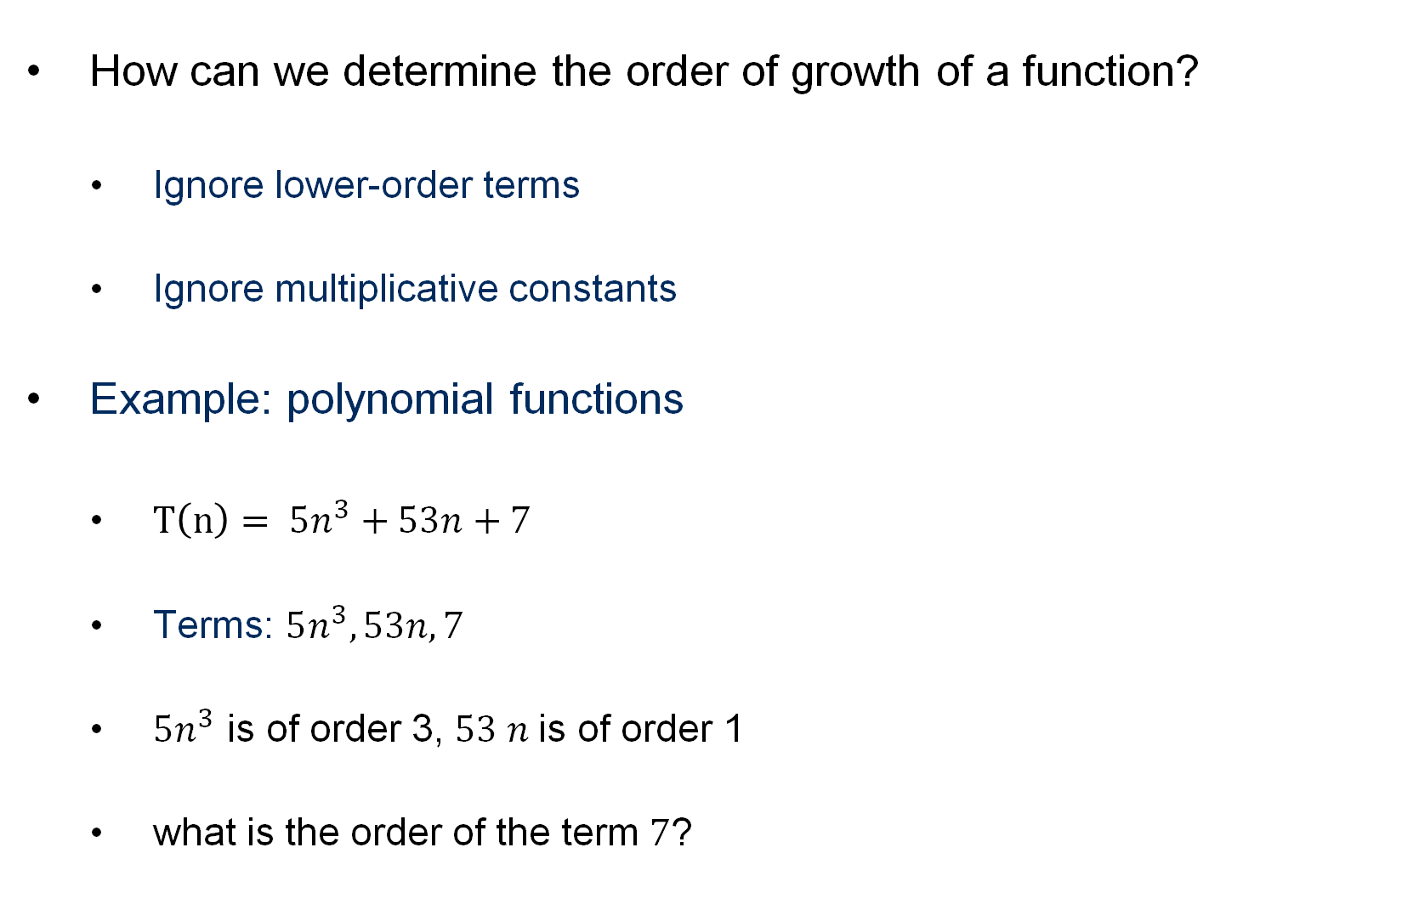
Quick algorithm analysis
How can we determine the order of growth of a function?
Ignore lower-order terms
Ignore multiplicative constants
Example: polynomial functions
$T\left(n\right)= 5n^{3}+53n+7$
Terms: $5n^{3}, 53n, 7$
$5n^{3}$ is of order 3, $53 n$is of order 1
what is the order of the term $7$?
Notes:
Wait, we just compared some function (e.g., n³) to the function modelling our runtime??
Can we use O for other resources??
YES! memory!

Slide 39
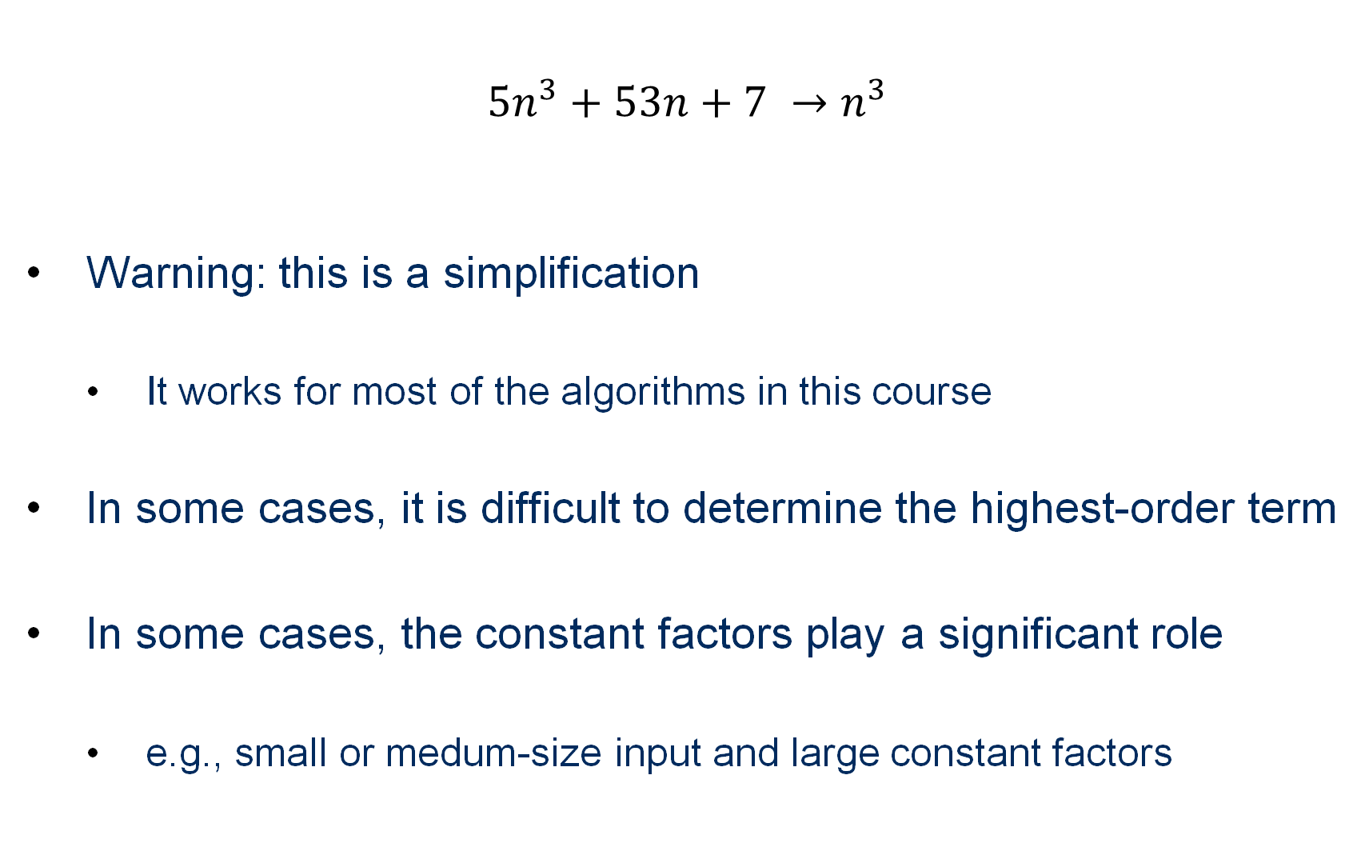
Example
$$5n^{3}+53n+7 →n^{3}$$
Warning: this is a simplification
It works for most of the algorithms in this course
In some cases, it is difficult to determine the highest-order term
In some cases, the constant factors play a significant role
e.g., small or medum-size input and large constant factors

Slide 40
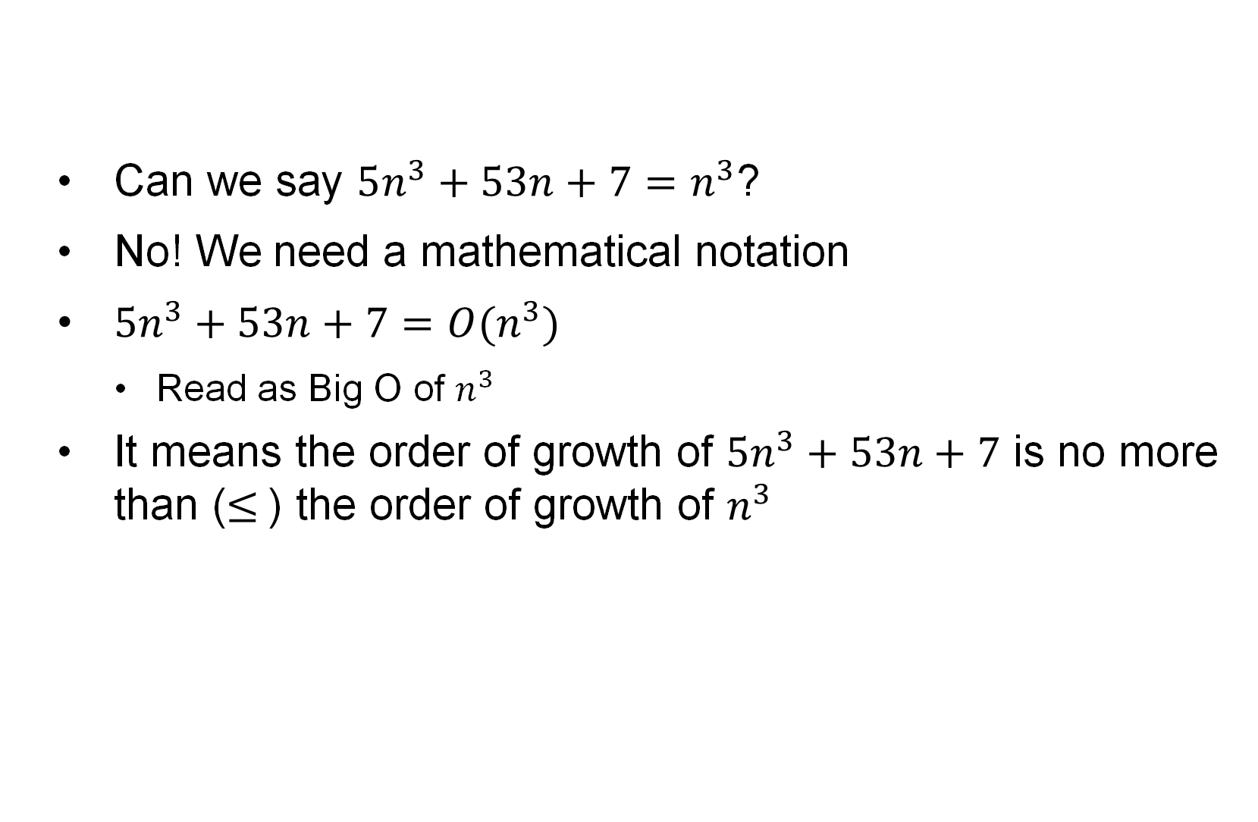
But …
Can we say $5n^{3}+53n+7=n^{3}$?
No! We need a mathematical notation
$5n^{3}+53n+7=O(n^{3})$
Read as Big O of $n^{3}$
It means the order of growth of $5n^{3}+53n+7$ is no more than ($≤$) the order of growth of $n^{3}$

Slide 41
Time complexity of an algorithm
Express the runtime function using Big-Oh notation
Ignore lower order terms
e.g., constant < log log n < log n < log²n < n < n log n < n² < n³ < 2^{n} < n!
e.g., n² + log n = O(n²)
Ignore constant factors
c*n = O(n), where c is a constant (doesn’t depend on n)
2^{cn} is not O(2^{n})
f(n) = 2n + 2 = O(2n) = O(n)

Slide 42
Notations
May also see:
f(x) ∈ O(g(x)) or
f(x) = O(g(x))
used to mean that f(x) is O(g(x))
Same for the other functions

Slide 43
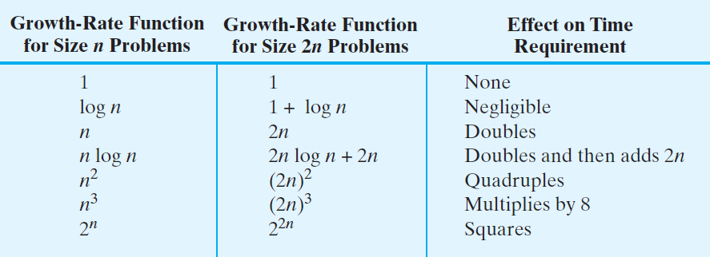
Picturing Efficiency
The effect of doubling the problem size on an algorithm’s time requirement

Slide 44
Riding Moore’s law
Writing an efficient algorithm (with less time complexity) is important
Such algorithm rides the exponentially-growing curve of hardware-speed ``better”
Problem size solvable by machine M using Algorithm B in T second
Problem size solvable by machine M using Algorithm A in T second
Number of operations that machine M can do in time T seconds

Slide 45
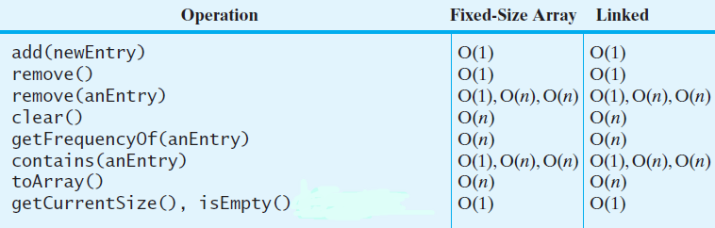
Efficiency of Implementations of ADT Bag
The time efficiencies of the ADT bag operations for two implementations, expressed in Big Oh notation

Slide 46
Big Oh Notation
A function f(n) is of order at most g(n)
That is, f(n) is O(g(n))—if
A positive real number c and positive integer N exist …
Such that f(n) ≤ c * g(n) for all n ≥ N
That is, c * g(n) is an upper bound on f(n) when n is sufficiently large

Slide 47
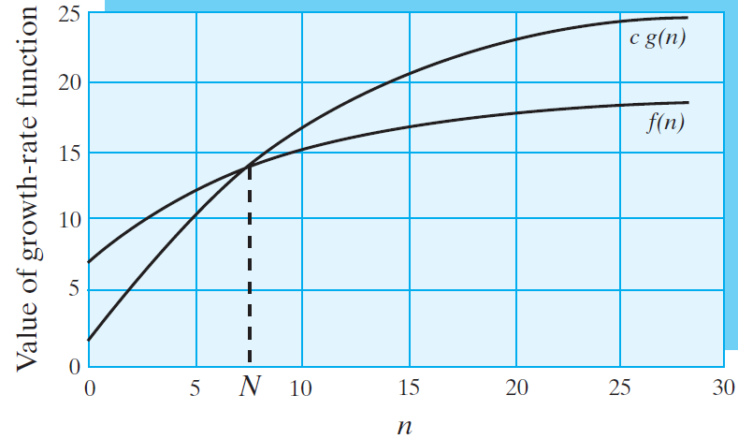
Big Oh Notation
An illustration of the definition of Big Oh

Slide 48
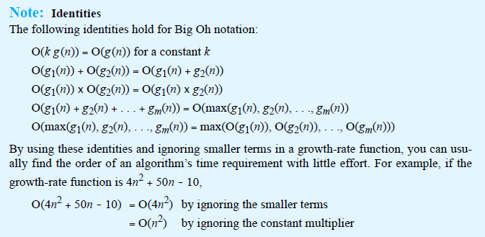
Big Oh Notation
Identities for Big Oh Notation

Slide 49
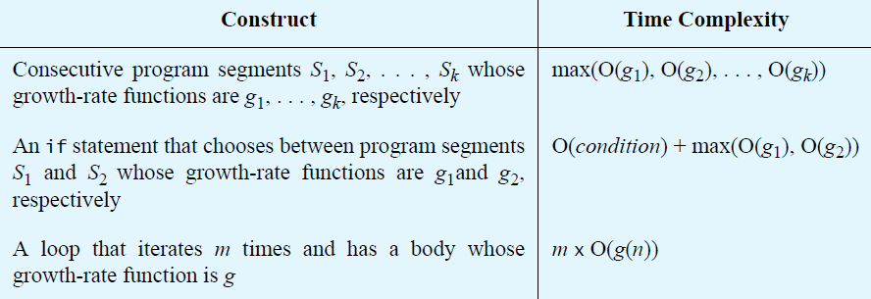
Complexities of Program Constructs

Slide 50
Best, Worst, and Average Cases
For some algorithms, execution time depends only on size of data set
Other algorithms depend on the nature of the data itself
For those, we have best case, worst case, average case

